Slide 1

Floral biodiversity estimation of grasslands in Franconia using Sentinel-2
12.03.2024
Laura Obrecht

Slide 2
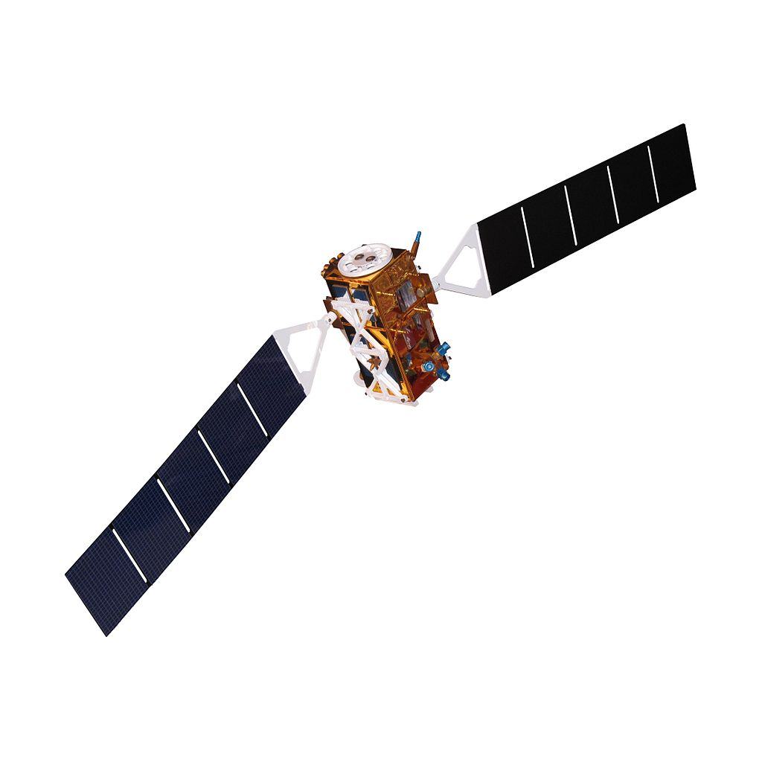
Topics

Slide 3
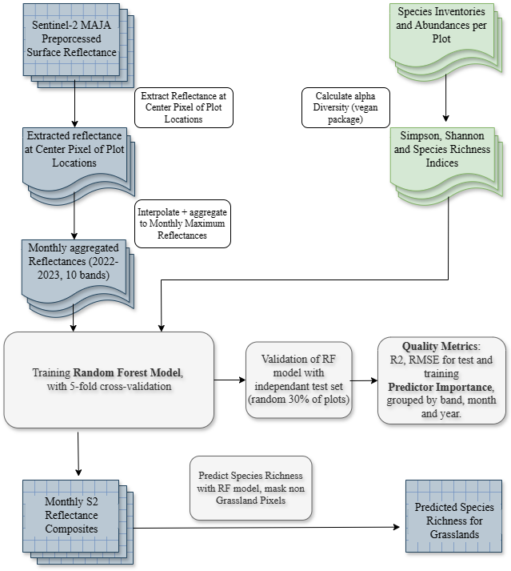
Workflow
Notes:
Information on code, packages

Slide 4
Alpha Diversity Indices
Species Number closest to „Normalverteilung“
Best Predictor, followed by Shannon Index

Slide 5
Random Forest Predictors
Training and Testing with data from Lower Franconia
Training and Testing with data from Lower Franconia and Ammer Catchment
Mowing Frequency, DOY of first Cut as additional Predictors
Notes:
Karten Untersuchungsgebiet (QGIS), Plot von Mowing Raster als Motiv
Duplicate Slide to present results for different cases in the end

Slide 6
Monthly Compositing of S2 Reflectance per Band
Trend per Band after Cut
Goal is to ensure that RF is not trained/influenced by Mowing Events/Frequency
Bands increasing after mowing are composited as minimum composites, bands decreasing are composited as maximum

Slide 7
Comparison of Compositing Methods
Predictors | Resp_var | seed | R2 | RMSE | stdev | var1 | var2 | var3
Median | specn | 75 | 0.644 | 5.399 | 0.286 | B3_2022.07 | B3_2023.08 | B11_2023.08
Median | specn | 3 | 0.68 | 5.223 | 0.261 | B4_2022.04 | B4_2022.03 | B3_2023.08
Median | specn | 87 | 0.675 | 5.714 | 0.236 | B11_2023.04 | B12_2022.03 | B4_2022.03
Median | specn | 77 | 0.734 | 5.443 | 0.226 | B4_2022.04 | B4_2022.03 | B12_2022.03
Median | specn | 67 | 0.507 | 5.357 | 0.324 | B4_2022.04 | B3_2022.09 | B5_2022.04
Max | specn | 86 | 0.617 | 5.517 | 0.269 | B12_2023.03 | B11_2023.03 | B4_2022.04
Max | specn | 40 | 0.576 | 5.435 | 0.304 | B5_2022.03 | B4_2022.04 | B12_2022.03
Max | specn | 84 | 0.677 | 5.27 | 0.258 | B11_2023.03 | B4_2022.04 | B5_2022.04
Max | specn | 38 | 0.588 | 5.443 | 0.26 | B11_2022.04 | B4_2022.04 | B11_2023.04
Max | specn | 3 | 0.654 | 5.525 | 0.269 | B5_2022.03 | B4_2022.04 | B11_2023.03
Min | specn | 51 | 0.663 | 5.449 | 0.265 | B12_2022.03 | B12_2022.04 | B4_2022.04
Min | specn | 41 | 0.663 | 4.951 | 0.276 | B4_2023.04 | B11_2023.03 | B11_2023.04
Min | specn | 91 | 0.766 | 5.225 | 0.19 | B5_2022.09 | B12_2023.03 | B11_2023.04
Min | specn | 43 | 0.667 | 5.484 | 0.234 | B5_2022.09 | B11_2023.03 | B4_2022.04
Min | specn | 10 | 0.733 | 4.822 | 0.223 | B2_2022.03 | B4_2022.04 | B12_2023.04
MaxMinperBand | specn | 39 | 0.682 | 5.068 | 0.254 | B12_2023.06 | B3_2023.08 | B11_2023.06
MaxMinperBand | specn | 53 | 0.72 | 5.01 | 0.18 | B3_2023.08 | B5_2022.09 | B3_2023.04
MaxMinperBand | specn | 45 | 0.687 | 5.326 | 0.243 | B5_2022.09 | B3_2023.08 | B11_2023.03
MaxMinperBand | specn | 27 | 0.675 | 5.325 | 0.253 | B4_2022.03 | B3_2023.08 | B5_2023.04
MaxMinperBand | specn | 8 | 0.685 | 5.016 | 0.253 | B3_2023.08 | B12_2023.03 | B4_2023.04

Slide 8
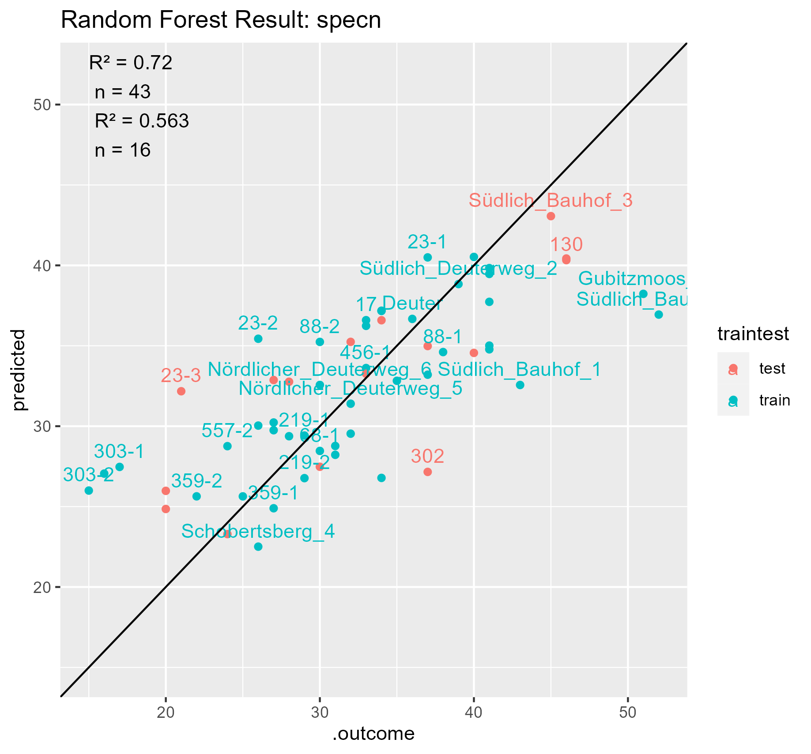
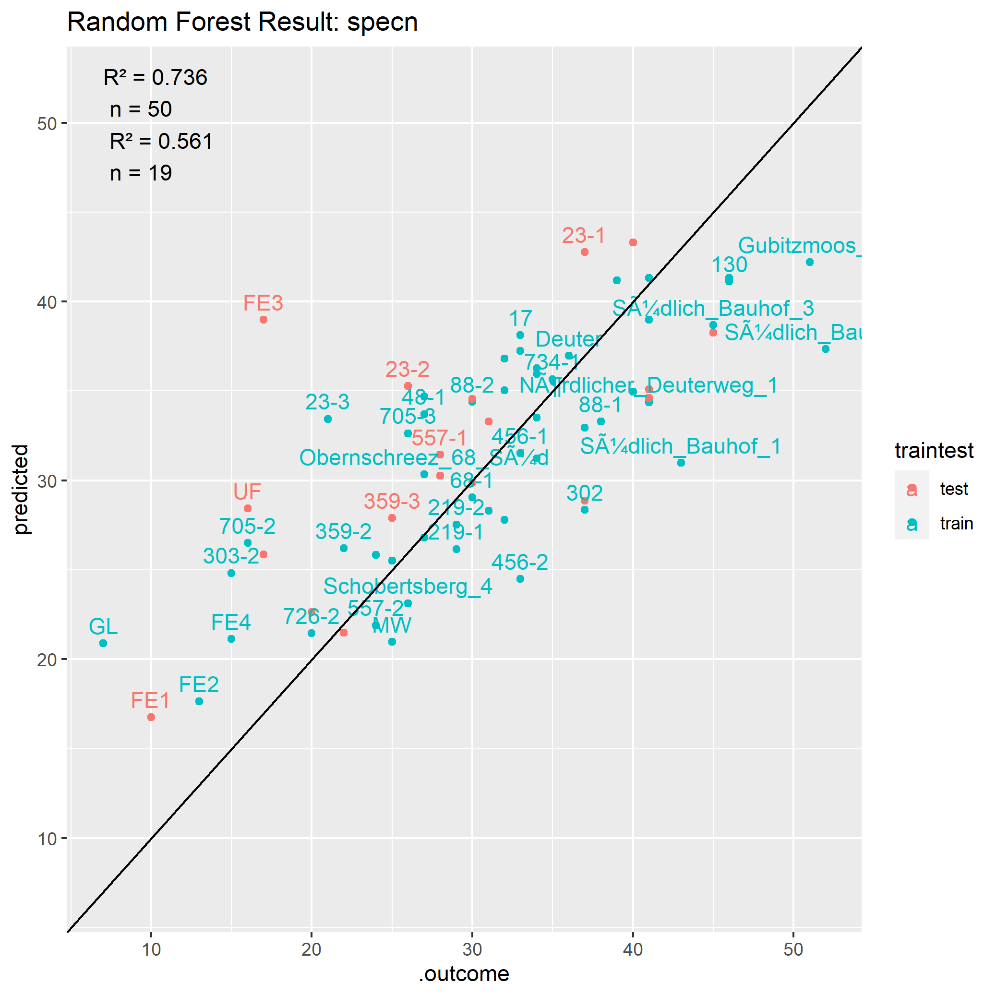
Comparison Training with and without samples from Ammer Catchment
Notes:
Ammer andere Form als Bayreuther Flächen

